Slide 1
Views, Tables, and Expressions
QuickStart Data Science Bootcamp
Week 2, March 30-31, 2020
Jonathan Fowler

Slide 2
Agenda
Table Variants
Temporary Tables
Common Table Expressions (CTE)
Views
Table Variables
Table-Valued Functions

Slide 3
Temporary Tables and CTEs
Temporary Table
Common Table Expression (CTE)
Exists temporarily for ad-hoc use
Disappears when connection is closed
Good for referring to multiple times in a session
Actually exists in tempdb
Example: https://www.sqlservertutorial.net/sql-server-basics/sql-server-temporary-tables/
Exists temporarily for ad-hoc use
Disappears when query is complete
Good for holding temporary results of query or just getting your head straight
Essentially disposable Views
Example: https://www.sqlservertutorial.net/sql-server-basics/sql-server-cte/

Slide 4
Views
Essentially saving a query for repeated use
Virtual table
Data is kept in the virtual table, not the original
Source table names are hidden
Can have multiple views of the same table, with variations
Some columns hidden for certain users
Calculations made
Column names changed
Can simplify complex joins

Slide 5
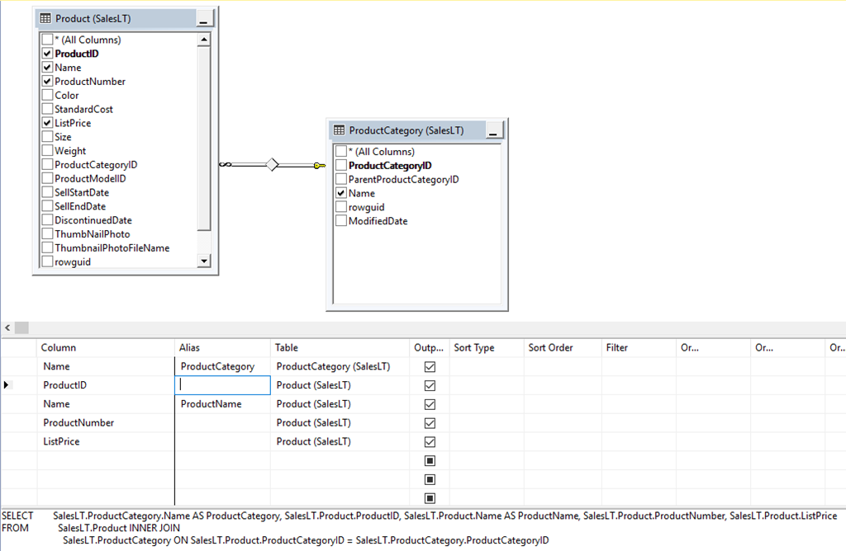
Views
Join condition
Table workspace
Column Workspace
SQL

Slide 6
Table Variables
Similar to temporary tables
Good for small amounts of data
Restricted to session that created them
Example: https://www.sqlservertutorial.net/sql-server-user-defined-functions/sql-server-table-variables/

Slide 7
Table-Valued Functions
Similar to querying a table with a given parameter
Good for restricting what data is returned
Example: https://www.sqlservertutorial.net/sql-server-user-defined-functions/sql-server-table-valued-functions/

